Slide 1
CBCD: Cloned Buggy Code Detector
Jingyue Li Michael D. Ernst
DNV Research & Innovation University of Washington

Slide 2
Overview
Cut-and-paste happens
An empirical study of cloned buggy code
4% of bugs are cloned in a commercial system
350 cloned bugs in Open Source Software
CBCD - A tool to detect cloned buggy code
(Optimizations of Program Dependency Graph based clone detection
for finding bugs and for scaling)
CBCD Evaluation
CBCD outperformed 4 clone detectors for this task

Slide 3
An empirical study of cloned buggy code

Slide 4
Have bugs been cloned?
Investigated systems
Linux kernel (OSS): millions of LOC
Git version control system (OSS): > 300 KLOC
PostgreSQL database (OSS): > 300 KLOC
A software product line (commercial): > 50 products, > 1 million LOC each
Approach
We searched for these keywords in bug reports and commit messages:
“same bug”, “same fix”, “same issue”, “same error”, and “same problem”
For each match, we manually determined whether the commit was necessitated by duplication of a bug
If so, we identified the buggy code and its clones manually

Slide 5
Results of the Empirical Study
OSS
 | Cloned bugs | Locatable clones
Linux kernel | 282 | 157
Git | 33 | 12
PostgreSQL | 33 | 22
For some bugs, we could locate their clones, e.g. in the commit, it says
“This is quite the same fix as in 2cb96f86628d6e97fcbda5fe4d8d74876239834c.”
For some other bugs, we could not locate their clones, e.g.
“Other platforms have this same bug, in one form or another.”
Commercial product line
969 out of 25420 bugs (3.8%)
No access to source code

Slide 6
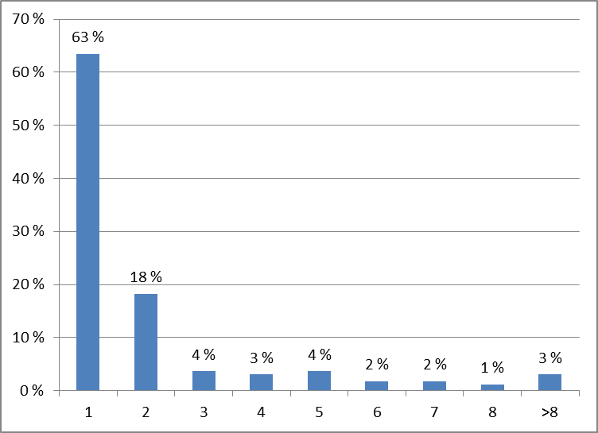
The Buggy Code Segment is Usually Small
More than 88% of the bugs cover 4 or fewer contiguous lines of code
Size (contiguous lines) of the largest component of each bug fix

Slide 7
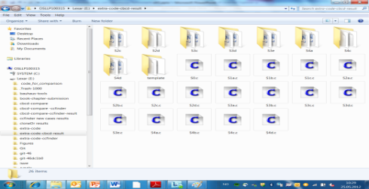
The Need to Detect Cloned Buggy Code
The empirical study confirmed that cloned bugs do exist
Once a bug is detected, it is necessary to find all its clones and fix them
Customer satisfaction drops when a customer re-encounters a bug that the vendor claimed to have fixed
Inputs
Output
Buggy code snippet
Entire system to be checked
Notes:
|

Slide 8
CBCD - A tool to detect cloned buggy code

Slide 9
CBCD Uses PDG-Based Clone Detection Approach
Clone detection approaches:
Text-based, Token-based, Abstract Syntax Tree (AST)-based
Program Dependency Graph (PDG)-based
PDG example
static int add(int a, int b) { return(a+b); }
Control dependency
Entry: add
Data
dependency
a = ain
b = bin
ret = result
result = a+b
PDG-based clone detection approach
Check graph isomorphism of PDGs of code segments to identify code clones
More resilient to code changes
CBCD: check whether PDG of the buggy code is a subgraph of the PDG of the system
Unlike other PDG-based tools, CBCD also requires vertex kind and source text match

Slide 10
CBCD Architecture
Subgraph isomorphism is O(N!N)
We implemented optimizations to reduce N
Bug
PDG
Input:
Buggy lines
Step 1:
Create Bug PDG
Split Bug PDG
Bug
vertex Info
Step 2:
Split the Bug PDG and prune the System PDG
Step 3:
Subgraph testing
(igraph)
Output:
Bug
clones
Input:
System to be checked
System
vertex Info
Pruned System PDG
Step 1:
Create System PDG
System
PDG
Vertex kind and source text are used to prune parts of System PDG that cannot match
Codesurfer
And also used in subgraph testing

Slide 11
Four Optimizations: Reduce the N in Subgraph Isomorphism
Isomorphism requires graph structure, vertex kind, and source text to match
More than 88% of the bugs cover ≤ 4 lines
1. Prune System PDG
Compare the start and end vertex kind and source text of edge of the System and Bug PDG
2. Break System PDG
Use vertex kind info. of Bug PDG to choose only small sections of the System PDG
3. Exclude irrelevant System PDG
Bug PDG
radius = 2
4. Break Bug PDG
System PDG

Slide 12
CBCD evaluation

Slide 13
CBCD Evaluation and Comparison with Clone Detectors
Research questions:
How well can CBCD find cloned buggy code?
How well does CBCD scale?
Oracle for the evaluation
53 bugs (34 Linux kernel, 5 Git, and 14 PostgreSQL) and their clones
Evaluation environment
Ubuntu 10.04, 4G Mem, 3Ghz CPU
Clone detectors under comparison
CBCD (PDG-based)
Simian (text-based)
CCFinder (token-based)
Decard (AST-based)
CloneDr (AST-based)

Slide 14
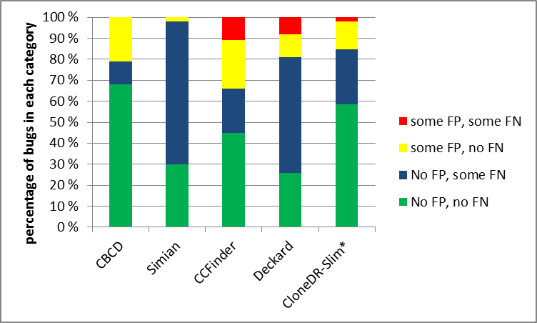
How Well Can CBCD Find Cloned Buggy Code?
For each investigated bug and each of its clone, we check if a tool reports
False Negative (FN): A clone is identified by the developer, but not by the tool.
False Positive (FP): A clone is repored by the tool, but not by developers as buggy.
Each of the 53 investigated bugs falls into one of four categories
* Only 2% of the input files and 1% of the lines of code
General clone detectors and CBCD are designed for different purposes
General clone detectors are good at finding large code clones
CBCD is more like an advanced “Find” command, good at finding small code clones

Slide 15
Advantages and Limitations of CBCD
Advantages: As expected, CBCD is more resilient to some types of code changes
Code deletions or insertions that do not change the PDG
Reordering of statements
Control-statement replacement
Limitations
False Positive : when the buggy code is a one-line function call
Buggy code: memset(ib_ah_attr, 0, sizeof *path);
True positive: memset(ib_ah_attr, 0, sizeof *path);
False positive: memset(p, 0, padding);
False Negative: Buggy code is in data structure or marcos, due to limitations of CodeSurfer.
False Negative: Variable renaming in an expression, because CBCD limits such renaming
Buggy code: if (!hpet && !ref1 && !ref2)
True positive: if (!hpet && !ref_start && !rf_stop)

Slide 16
How well does CBCD scale?
<47 seconds to find clones of a bug in a system having ≥ 400 KNLOC, after the system PDG is generated by CodeSurfer
Generating system PDG from CodeSurfer is the bottleneck
However, this step needs to be done only once and is reusable
The optimizations are effective
Most effective: Prune System PDG
Pruned 90% of the edges
20237× and 11890× performance improvement in two cases
Avoid “out-of-memory” error due to too big System PDG in another case
Other optimizations provide moderate performance gains

Slide 17
Conclusions
Examined real-world bug reports
Established that identical (cloned) bugs are a serious problem
Proposed that programmer should search for clones of buggy code
Optimizations to PDG-based clone detection algorithms for scalability
Implemented CBCD, a PDG-based tool that detects possible clones of buggy code
CBCD is scalable, effective, and outperforms other tools for this task
Finding cloned bugs is very important, and now a tool (CBCD) exists for that!

